Slide 1



Jet Propulsion Laboratory
California Institute of Technology
Deep Impact Network Experiment
(DINET)
Disruption Tolerant Network Technology Flight
Validation Report
by Ross M. Jones
Jet Propulsion Laboratory
California Institute of Technology
ComNet Group Presenters: Sotirios – Angelos Lenas and Nikolaos Bezirgiannidis

Slide 2
Overview
Install and test essential elements of DTN technology on the Deep Impact spacecraft (16 - 24 million Km from Earth)
300 images were transmitted from the JPL nodes to the spacecraft. Then, they were automatically forwarded from the spacecraft back to the JPL nodes
The DINET experiment was held by JPL and sponsored by NASA
Performed in close cooperation with the EPOXI project
Period of experiment: 27 days (October – November 2008)
Demonstrate DTN readiness for operational use in space missions
ComNet Group 1/20

Slide 3
Innovations
First deep-space node on the Interplanetary Internet
  Automatic, contact-sensitive relay operations (store-and-forward Bundle Protocol)
  Automatic rate control
  Delay-tolerant retransmission (Licklider Transmission Protocol)
  Prioritization of merged traffic flows
  Custody transfer
Longest digital communication network link ever
First use of dynamic routing over deep space links
First use of messaging middleware (CCSDS Asynchronous Message Service publish/subscribe) over deep space links
ComNet Group 2/20

Slide 4
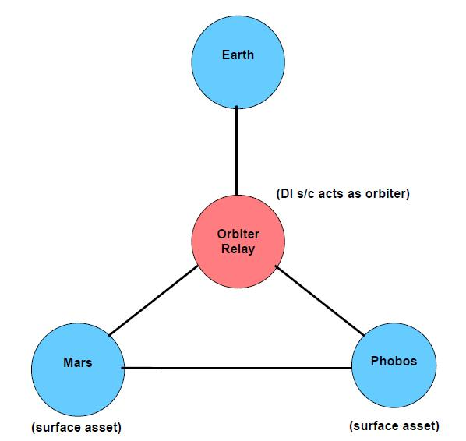
Topology
All the nodes, except for the Deep Impact spacecraft, were physically located in the JPL Deep Space Operations Team (DSOT) area or in the Protocol Test Laboratory (PTL)
ComNet Group 3/20

Slide 5
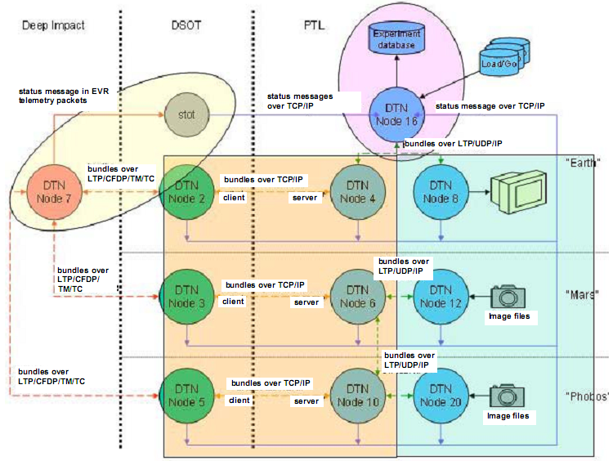
Configuration settings 1/2
Convergence-layer protocols on experiment topology:
ComNet Group 4/20

Slide 6
Configuration settings 2/2
Images sent at priorities 0, 1. Network management traffic, custody signals, critical images sent at priority 2
Custody transfer on all application bundles
Bundle headers were CBHE-compressed
Time-to-live was 10 days for all image bundles
Max bundle size was 64 KB. Max LTP segment size was 739 bytes
Contact Graph Routing used to compute routes dynamically
ComNet Group 5/20

Slide 7
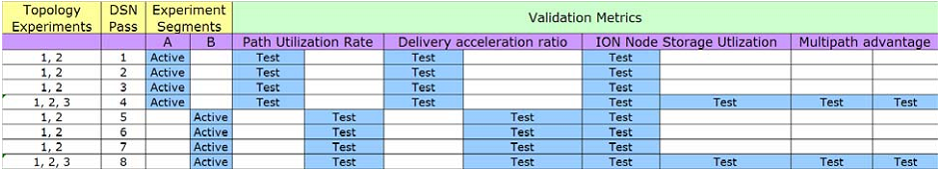
Experiment Schedule
The 4-week period of DINET operations was divided into two configurations (a and b) of four tracking passes each.
  Configuration a → no injection of artificial data loss
  Configuration b → 3.125% of all LTP segments were randomly discarded upon reception at the DI spacecraft and at DSOT nodes
ComNet Group 6/20

Slide 8
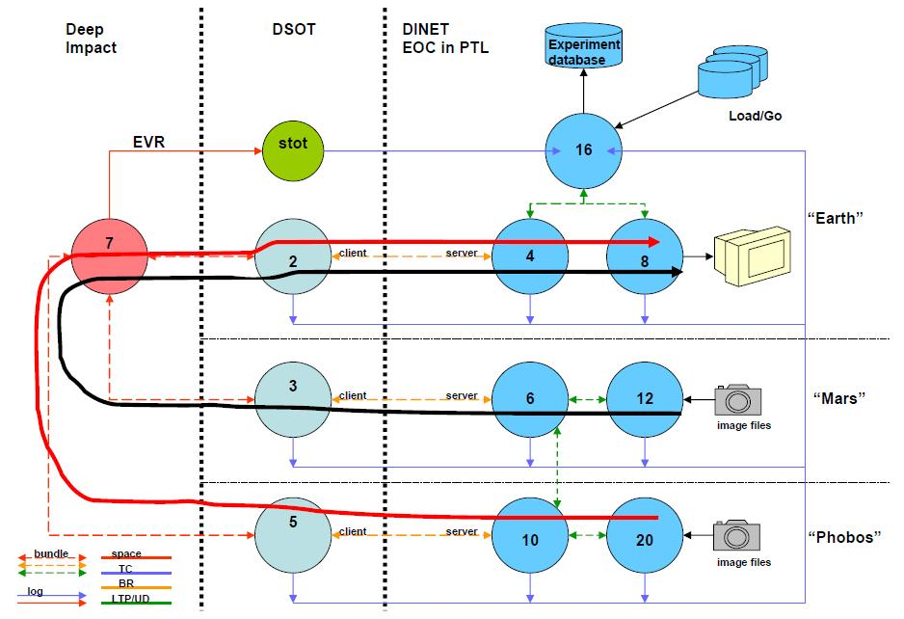
Experiment 1
ComNet Group 7/20

Slide 9
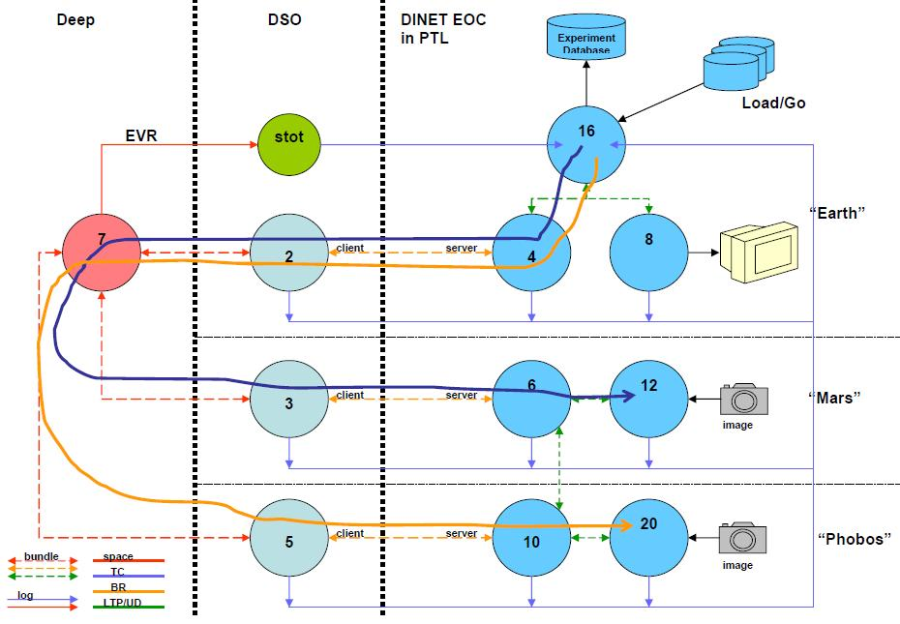
Experiment 2
ComNet Group 8/20

Slide 10
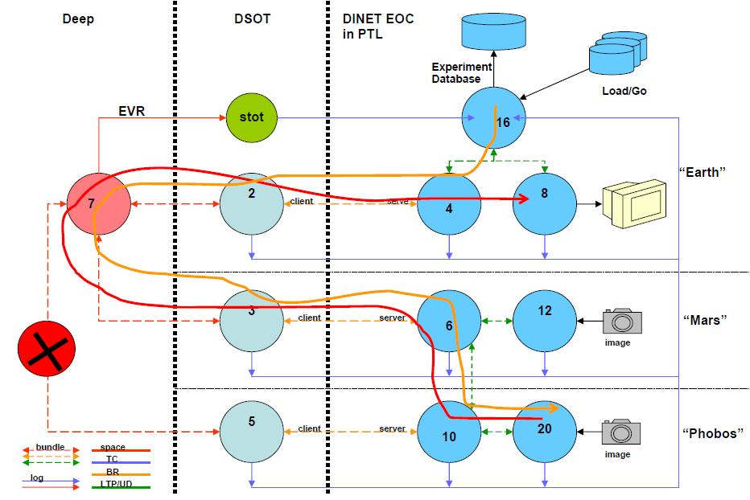
Experiment 3
ComNet Group 9/20

Slide 11
Investigation Elements
DTN Bundle:
  Origination
  Transmission
  Acquisition
  Dynamic route computation
  Congestion control
  Prioritization
  Custody transfer
  Automatic retransmission procedures
ComNet Group 10/20

Slide 12
Validation Objectives
DTN performance metrics:
  Path Utilization Rate
    Automatic forwarding
    Custody transfer
    Delay – tolerant retransmission
  Delivery Acceleration Ratio
    Priority system
  ION Node Storage Utilization
    Congestion control
  Multipath Advantage
    Dynamic routing
ComNet Group 11/20

Slide 13
Terms of Validation 1/2
XYZ → the transmission opportunity from node X to node Y on DINET pass or configuration Z
D_{XYZ} → Duration of XYZ in seconds
C_{XYZ} → Data rate in bytes/sec
K_{XYZ} → Raw capacity (D_{XYZ} * C_{XYZ})
S_{XYZ} → Total data return capacity ΣK_{XYZ} for Z = 1-4 (a) or Z = 5-8 (b)
R_{PZ} → Volume of priority-P science data (ex. priority 0 – conf a: R_{0a})
  R_{Ta} = R_{0a}+ R_{1a} + R_{2a}
W_{Ta} = R_{0a}+ (2*R_{1a}) + (4*R_{2a}) → Urgency-weighted volume of science data (configuration a)
ComNet Group 12/20

Slide 14
Terms of Validation 2/2
Q_{Ta} = λ * R_{Ta} → Reference volume of priority T science data,
  λ → proportion of image bundles with priority T
V_{Ta} = (0.5 * Q_{0a}) + Q_{1a} + (2.0 * Q_{2a}) → Urgency-weighted reference volume of science data
I_{X} → Size of the ION data store at node X
A_{X} = 0.6 * I_{X} → Size of the traffic store allocation at node X
N_{XZ} → Total unassigned space at node X for pass Z
P_{XYa} = min(ΣK_{ijZ}), Z = 1-4 → Net path capacity from X to Y (config. a)
ComNet Group 13/20

Slide 15
Experiment Results
Metric 1 – Path Utilization Rate (U)
U_{a}= R_{Ta} / S_{M2a} (Volume of priority-P science data / Total data return capacity)
Validation criteria:
  Ua > 90% (DTN uses both high-rate and low-rate links efficiently)
  Ub > 90% (DTN remains efficient despite an increase in the rate of data loss)
Analysis of the DINET experiment log indicates that Ua was 76.2% and Ub was 72.4%
However
  Passes 2 and 8 were underutilized due to anomalies so their path utilization don’t reflect protocol efficiency
  20% of uplink capacity was by link service overhead (telecommand coding)
Final result
  Ua = 97.4
  Ub = 92.5
Both validation criteria were satisfied
ComNet Group 14/20

Slide 16
Experiment Results
Metric 2 – Delivery Acceleration Ratio (G)
G_{a} = W_{Ta} / V_{Ta} (Urgency-weighted volume of science data / Urgency-weighted reference volume of science data)
Validation criteria:
  Ga > 1.05 (Prioritization accelerates the delivery of urgent data)
  Gb > 1.1 (The advantage of prioritization increases with the rate of data loss)
Analysis of the DINET experiment log indicates:
  Ga = 1.10
  Gb = 1.12
Both validation criteria were satisfied
ComNet Group 15/20

Slide 17
Experiment Results
Metric 3 – ION Node Storage Utilization
Validation criteria:
  Total number of bundles for which custody is refused anywhere in the network (“Depleted Storage”) → Always zero, throughout each configuration
    Never run out of storage anywhere
  N_{X7} = N_{X6} for all values of X → True for all nodes (Storage utilization stabilizes over the course of network operations)
Both validation criteria were satisfied
ComNet Group 16/20

Slide 18
Experiment Results
Metric 4 – Multipath Advantage
M_{XY} = ΣP_{XY} / max(P_{XY}) – 1 (Net path capacity from X to Y)
Validation criterion:
  The multipath advantage for traffic from node 20 to node 8 is greater than 20% (Dynamic routing among multiple possible paths increases the total network capacity from Phobos to Earth)
The computed multipath advantage for traffic from node 20 to node 8 through the entire DINET experiment was 27%
The validation criterion was satisfied
ComNet Group 17/20

Slide 19
Anomalies
DTN-Related
  Apparent image arrival out of priority order in pass 2
  Underutilization of link in pass 2
  Loss of advantage provided by alternative route (cross-link between nodes 6 - 10)
  Bundle expiration on EPOXI
  Underutilization of link in pass 8
  Custody refusal at node 5 due to redundant reception
  Unexplained “watch” characters
  Aggregate capacity overflow
Other Types of Anomalies
  Software
  Hardware
  Environmental
  Procedural
ComNet Group 18/20

Slide 20
Technical Significance
DTN can work in deep space
Successfully demonstrated over a variety of conditions with realistic traffic patterns
Validation objectives were met
Network function were completely automated
Automatic identification of missing data and selective retransmission
Total lack of data corruption
ComNet Group 19/20

Slide 21
Strategic Significance
Network protocols of DINET can be used universally
DINET code is available for immediate use
Priority management promises better network utilization of available BW
Low operations labor costs due to automatic (internet-like) data exchange between nodes
Lack of human intervention results in saving time and money
ComNet Group 20/20

Slide 22
Thank you for your attention!
Questions?

