Slide 1
Evaluation of Dynamic DTN Routing Protocols in Space Environment
Authors:
Ioannis Komnios
Sotirios Diamantopoulos
Vassilis Tsaoussidis
ComNet Group

Slide 2
Problem
Routing in DTN environments is an open issue
  No consensus reached yet
Several approaches have been proposed
  Each one of them may perform better under specific conditions, eg. DTNs with small delays or with random connectivity pattern
ComNet Group

Slide 3
Paper objective
Which routing protocol performs better in Space environment, where conditions such as long delays and high error rates are present
Research Methodology
Emulations using ComNet Lab’s DTN testbed
Statistical analysis
ComNet Group

Slide 4
Protocol Description
Epidemic routing
  Transmitted data is continuously replicated until all nodes receive a copy
  If a path towards the receiver is to become available any time in the future, it will be utilized for successful delivery
  Drawback: Excessive use of network resources (bandwidth, storage)
ComNet Group

Slide 5
Protocol Description
Probabilistic Routing Protocol using History of Encounters and Transitivity (PRoPHET)
  It utilizes knowledge of previous encounters to calculate a delivery predictability to each node
  Opportunistic contacts are utilized too
  Drawback: there is message exchange prior to each transmission
ComNet Group

Slide 6
Protocol Description
Contact Graph Routing (CGR)
  It utilizes knowledge of all scheduled future communication contacts
  Routes can be static, dynamic or default
  No exchange of connectivity information prior to data transmission is needed
  Drawback: opportunistic contacts cannot be exploited
ComNet Group

Slide 7
Protocol Description
 | Epidemic Routing | PRoPHET Routing | Contact Graph Routing
Energy-Efficient | No | No | Yes
Autonomous | Yes | Yes | No
Contacts Exploited | All | All | Scheduled Only
QoS | No | No | Yes
ComNet Group

Slide 8
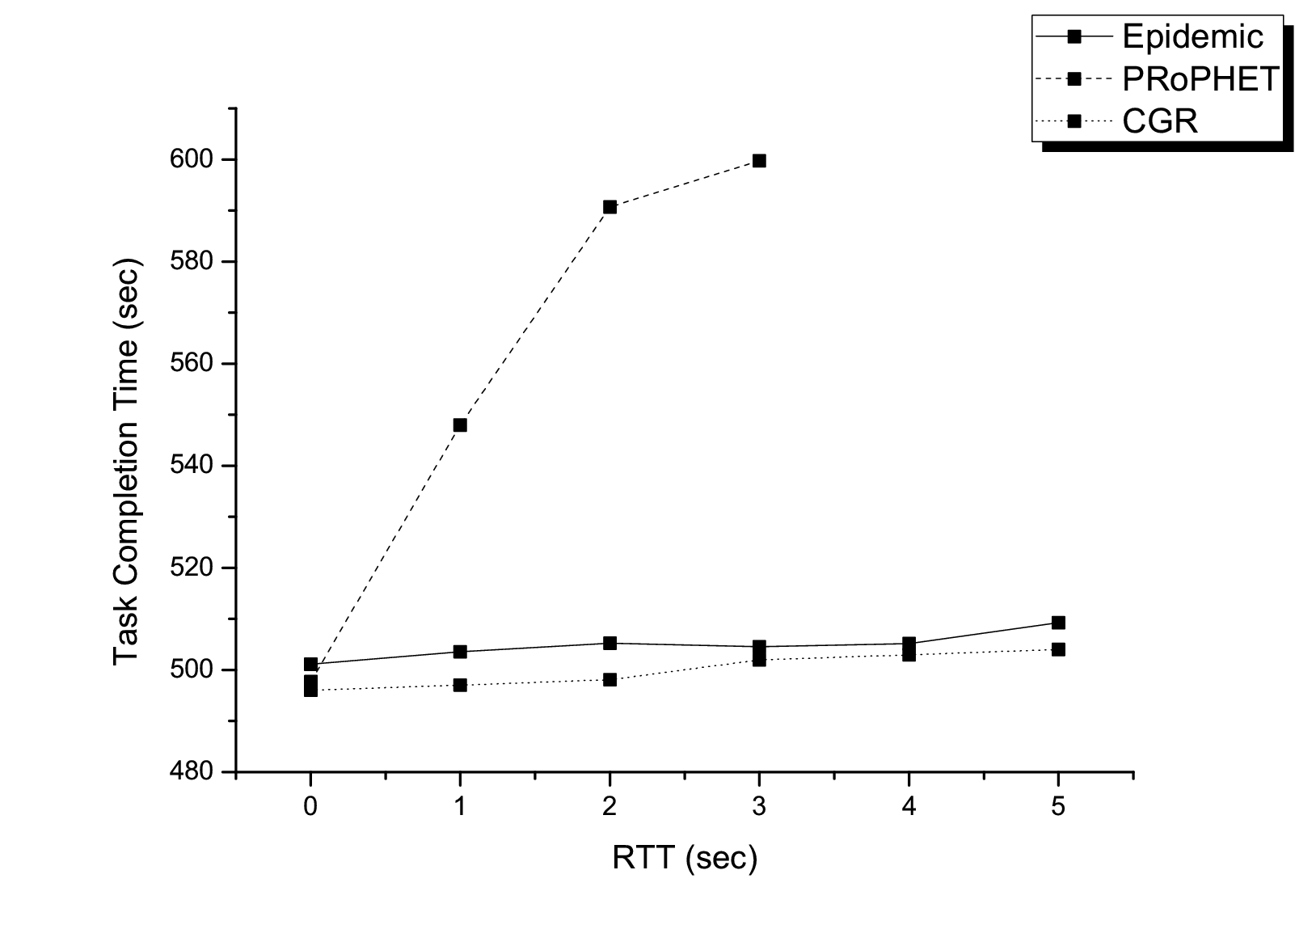
Experimental Results
Round-Trip Time Impact on Task Completion Time
  Topology: 2-hop, alternate path
  Transmission: 100 packets of 10 KB each, one every 5 seconds
ComNet Group

Slide 9
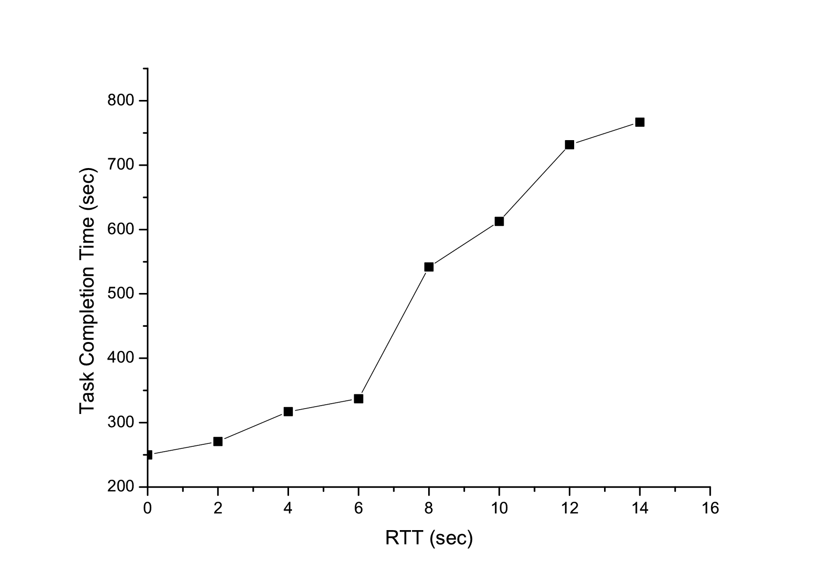
Experimental Results
Task Completion Time for varying RTT using PRoPHET
  Topology: Single-hop
  Transmission: 50 packets of 10KB each, one every 5 seconds
ComNet Group

Slide 10
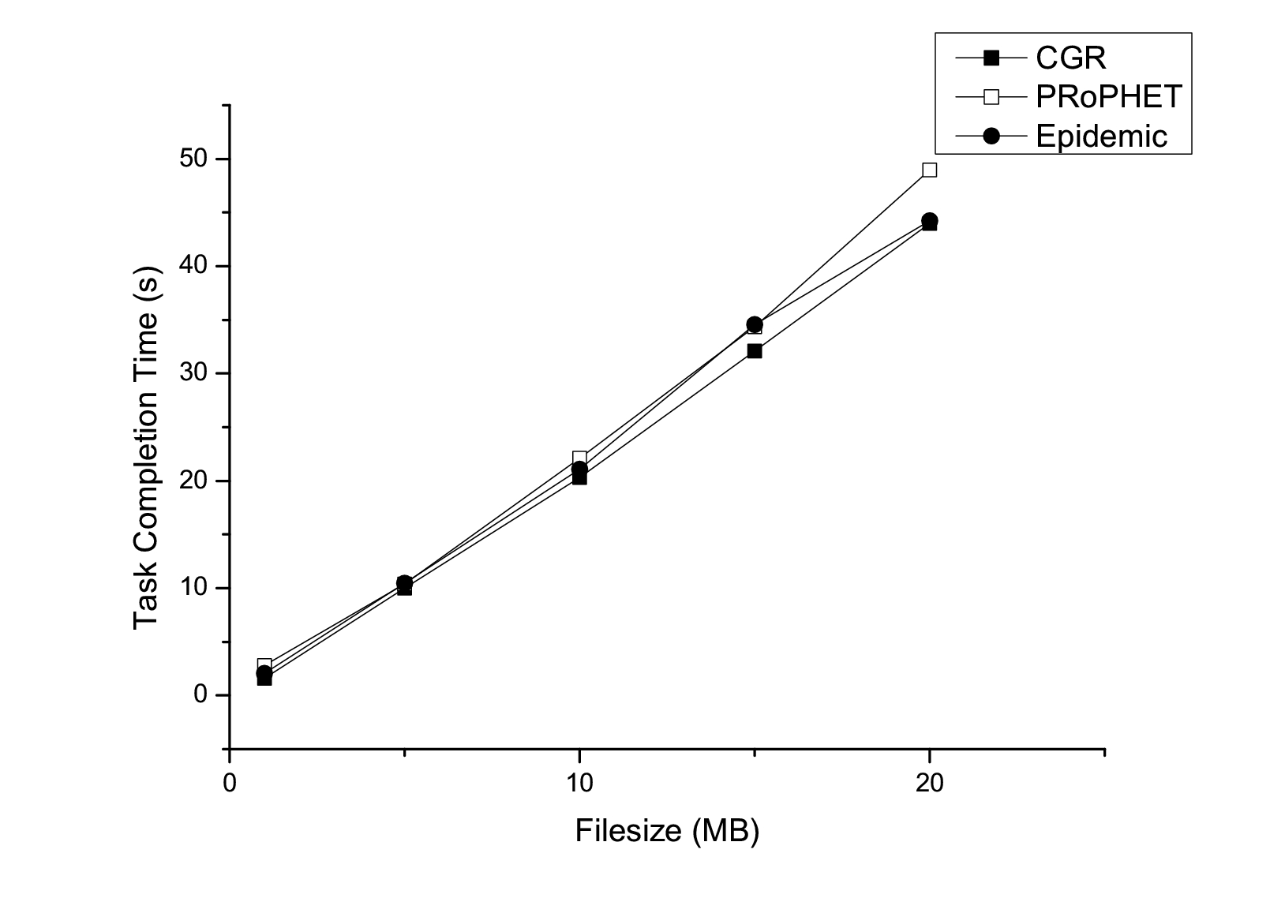
Experimental Results
Task Completion Time for varying Filesize
  Topology: 2-hop, alternate path
  Transmission: one file of variable size
ComNet Group

Slide 11
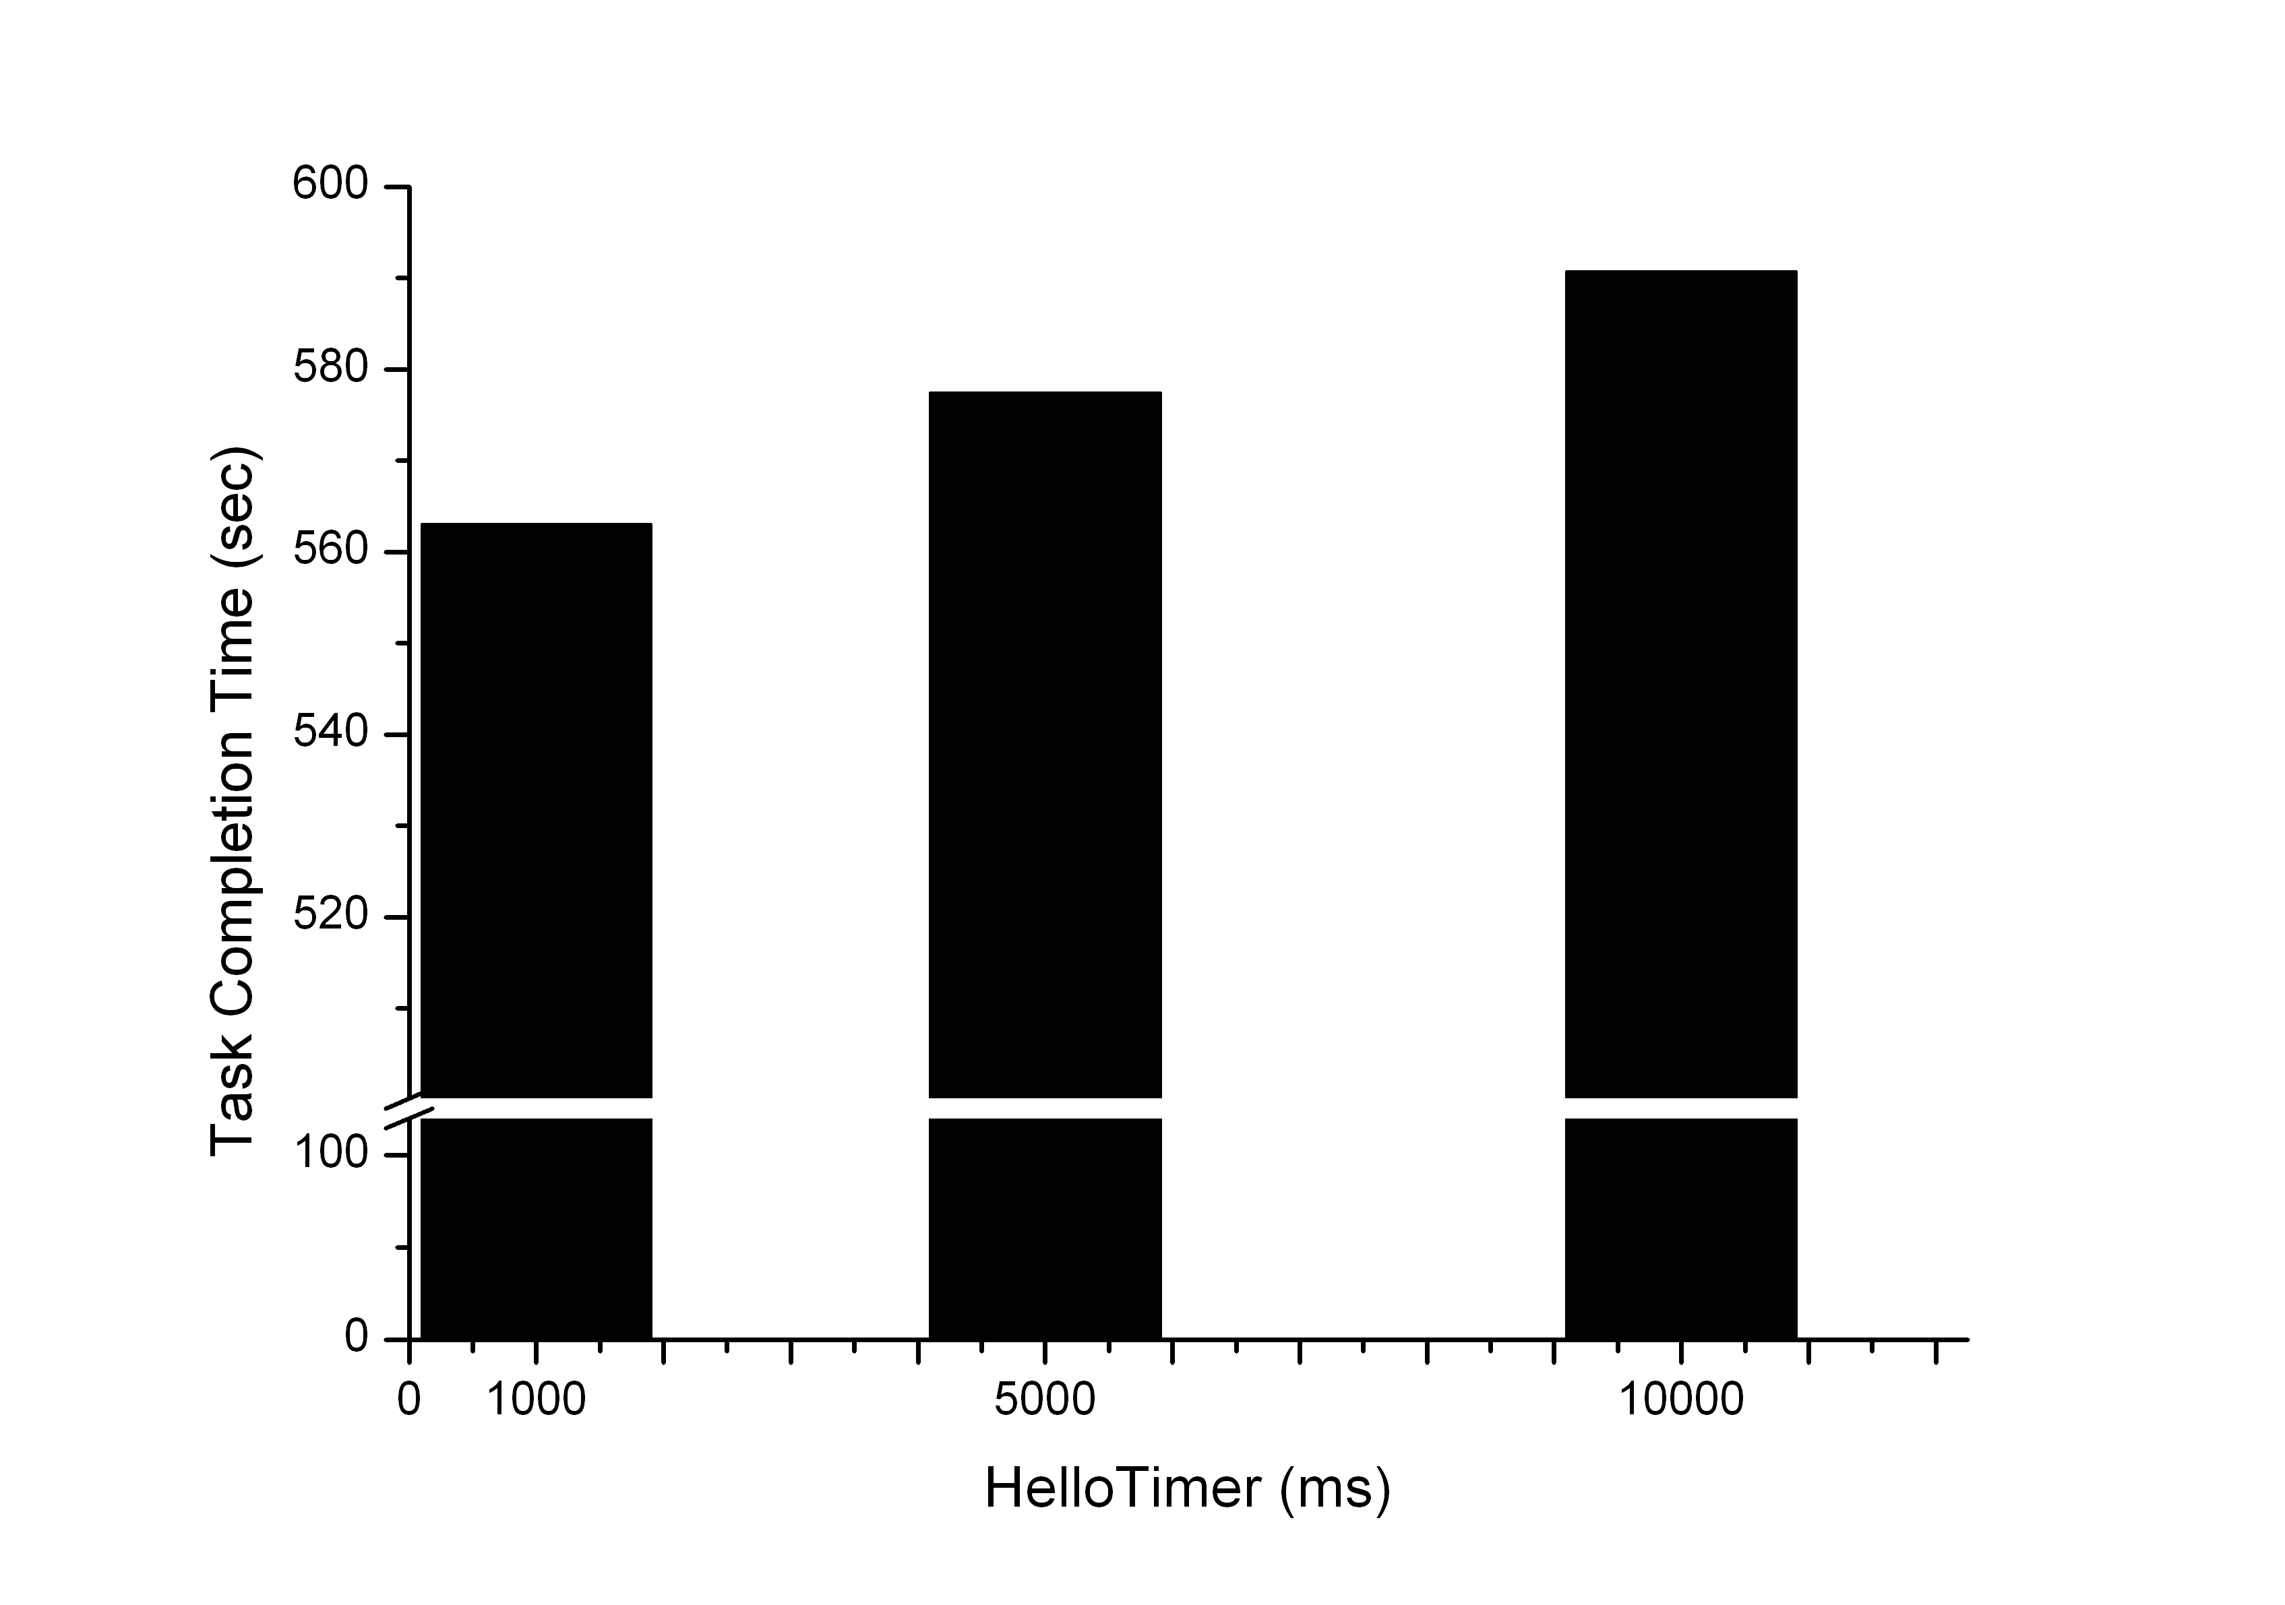
Experimental Results
Task Completion Time for varying PRoPHET’s Hello Timer values
  Topology: 2-hop, alternate path, 2 seconds delay at every link
  Transmission: 100 packets of 10 KB each, one every 5 seconds
ComNet Group

Slide 12
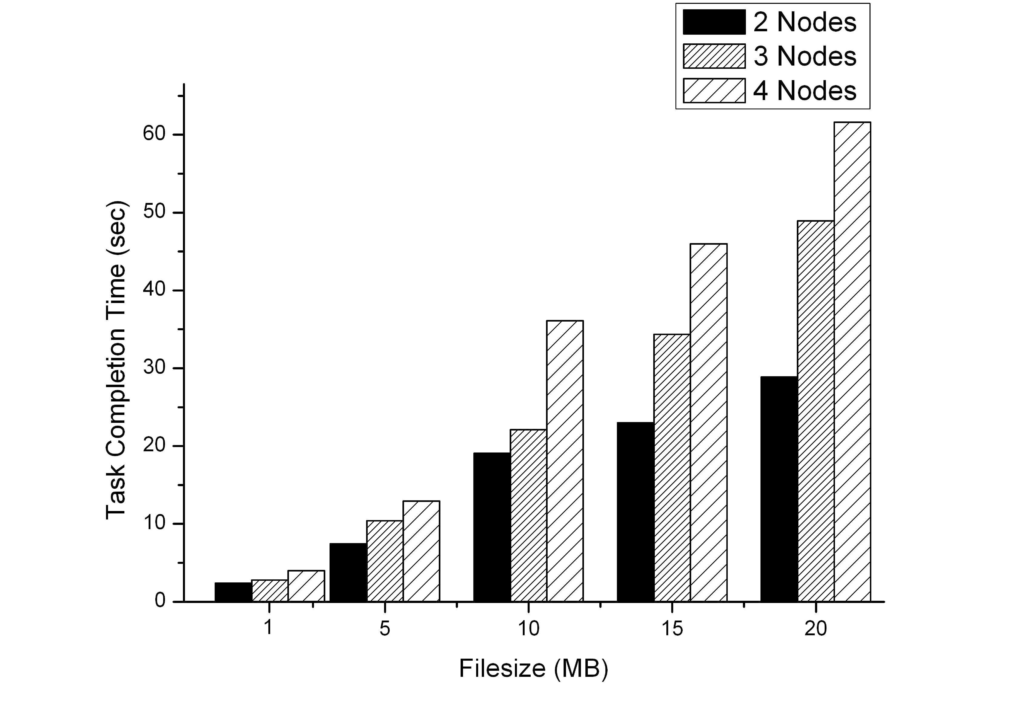
Experimental Results
Task Completion Time for varying number of intermediate nodes using PRoPHET
  Transmission: one file of variable size
ComNet Group

Slide 13
Conclusions
CGR achieves considerably better performance than Epidemic and PRoPHET routing when delay is in the order of seconds
PRoPHET does not perform well even for short delay values, neither for small nor for large filesizes
ComNet Group

Slide 14
Any questions?
Thank you…
ComNet Group

